Slide 1

z/OS DevOps DBB/Git/UCD Pipeline Executive Summary
Nelson Lopez
Z DevOps Transformation Specialist
Nelson.lopez1@ibm.com

Slide 2

The 6 core DevOps capabilities
Continuous Integration
Discover and unleash IBM Z through API’s
Improve speed and quality
Optimize Cost and Skills
{...}
$
Automated Testing (zUnit..)
Bring your own IDE
(IDz)
Enterprise class discovery and intelligence
(ADDI)
Enterprise wide standardization with an open pipeline
(, Jenkins, Azure …)
Dependency Based Build
(DBB)
On demand development and test environments
(zD&T)
Notes:
IBM identifies 9 core competencies that have helped enterprises successfully navigate in their journey to cloud, and address challenges with Managing Hybrid cloud environments, drive resiliency and optimizing costs and skills. Maturity in the 9 core competencies also result in organizations break the silos and achieve AI driven Operations (aka AIOps). The 9 core competencies are
Monitor and analyze hybrid Infrastructure for health, availability, performance for the entire system and sub-systems, to help IT Operators proactively identify issues that can result in downtime or other performance issues.
Automate to improve quality of service with a single point of control and integrated workflow across provisioning and management of hybrid cloud platforms.
End-to-end Application visibility for application performance, for faster problem isolation and minimizing costly war rooms.
4. Enhance infrastructure resiliency by automating to respond to events / triggers and to guarantee continuous availability.
5. Ensure workload resiliency by ensuring faster time to recovery from batch workloads failures.
6. Proactively identify and resolve issues. Artificial Intelligence and Machine learning are paving the way for enterprises to detect anomalies in the system faster, and remediate them quickly before they even happen.
7. With the looming retirement for the Mainframe administrators, and the new generation of IT Operators coming onboard – it is critical to bridge the skill gaps quickly. Many next generation IT Operators aren’t familiar with the 3270 interfaces, and are more used to mobile apps or web browsers. Bridge skill gap is an important competency helping collaboration and bridging skill gap between the 2 generations of IT Operators
8. Optimize Workload performance helps enterprise leverage licensing models that align with the Hybrid Cloud e.g Tailor Fit Pricing and also identify and optimize performance issues impacting their costs.
9. Finally, enterprise must be able to Forecast the performance and capacity needs for their system, to deliver optimal customer experience while staying compliant.

Slide 3
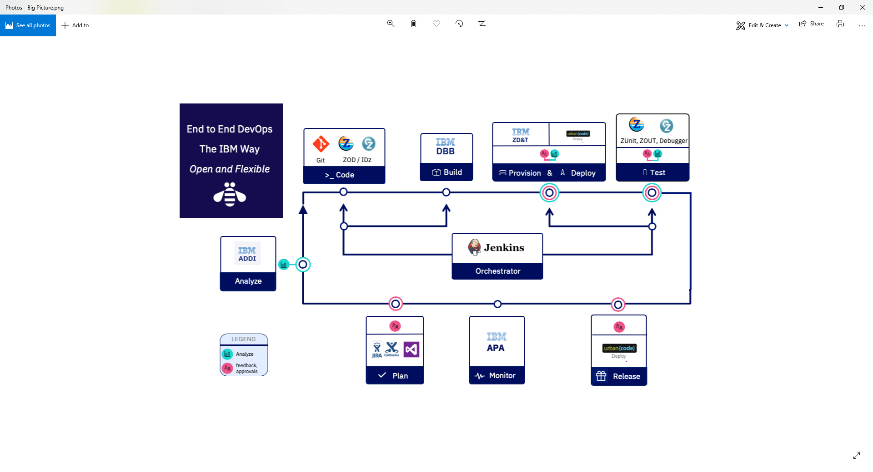
CI Phase

Slide 4

Some Git Concepts

Slide 5
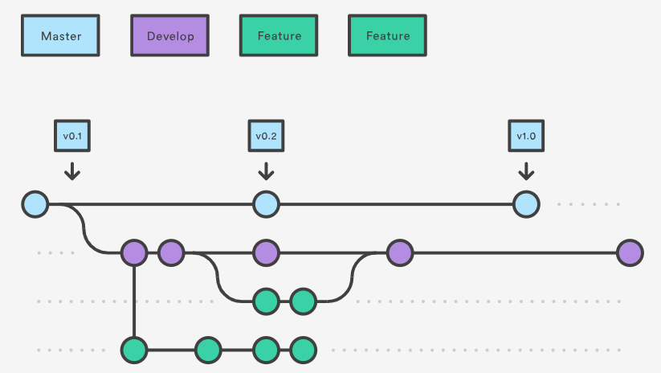
Git Branching & Workflow
Master – The gold copy of source code “Always Deployable”
Develop – A ‘team’ branch for integrated builds and testing
Feature – Developers personal branches for isolated User Builds and Unit Testing
TIME
Supporting Agile workflows
Notes:
https://www.atlassian.com/git/tutorials/comparing-workflows/gitflow-workflow
Sample Multi Repo Clone
$ mkdir multirepository-cache.git
$ cd multirepository-cache.git
$ git init --bare
$ git remote add parent https://github.com/jenkinsci/git-plugin
$ git remote add child-1 https://github.com/jenkinsci/git-client-plugin
$ git remote add child-2 https://github.com/jenkinsci/platformlabeler-plugin
$ git fetch --all

Slide 6



From CI to CD
GIT – Branching Model
Pipeline
CI
CD
M
M+1
Merge/rebase - Master
Prod M+1
Sprint
R+1
Release – Final Build
QA/UAT
R+1
D
PR – Integration Build
Team
F
F
User Feature build
User
F
BUILD
DEPLOY
RUN
M=Master, D=Develop, F=Feature, R=Release, +1 is a new tag version, Long Lived Branch

Slide 7
IBM’s Dependency Based Build (DBB)
Continuous Integration

Slide 8
DBB - A Modern Mainframe Build Tool
DBB enables modern automated mainframe Builds (no JCL, TSO/ISPF, SDSF, PDS…)
Fully integrated with all modern DevOps tools like
Jenkins, Azure
IDE’s like IDz
Git
Empower your next-Gen Developers with “Familiar” tooling (Git, Eclipse, Scripting…)

Slide 9


DBB’s Intelligent Build
Copybook1
Tracks Dependencies and changes between programs & copybooks to drive intelligent, efficient builds
PGM-A
Copybook2
PGM-B
Copybook3
PGM-C
Static Link

Slide 10
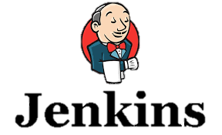





DBB Sample Architecture
DBB WebApp
Dependency Metadata
Build Results History
3- Start
Pipeline
Server
z/OS
DB
Any Git Server
DBB Java Toolkit
2- Pull Request
Master Repository
CLONE to Z
MVS Java API’s
PDS
Agent
Local
repo
Groovy Build scripts
Compile
&
link
Scan, impact analysis, copy to PDS, compile, create artifacts, & report
1- Push
Run Groovy build script
Return status and Logs
Local Repo
USS
MVS
Desktop IDz
Notes:
FYI – IBM Offers Elite Support for Rocket Git for zOS (part # D226Qll) contact your sales rep for details

Slide 11
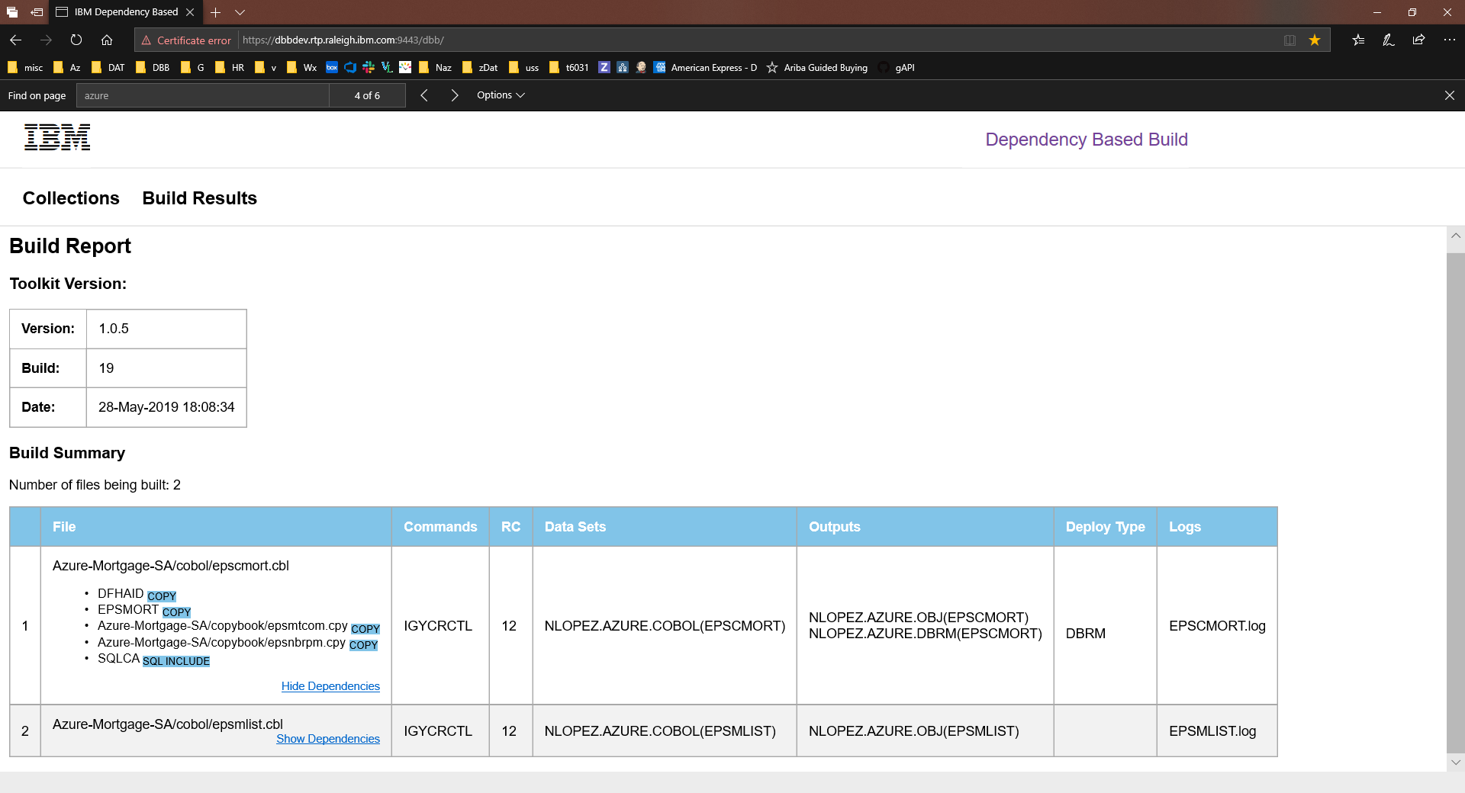

Slide 12

Continuous Deployment

Slide 13

CD Phase
Notes:
What we want to do is provide this pipeline as the automation framework for the DevOps transformation

Slide 14
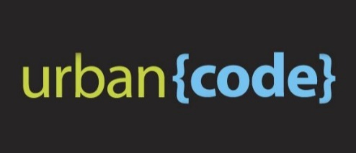
DBB/UCD – Build, Package, Release, Deploy
GIT
Urban Code Deploy
DBB
Build.groovy
Build
UCD Code Station
Component Versions
BuildReport.json
TARFILE
TARFILE
DBB
deploy.groovy
Package
TARFILE
TARFILE
Deploy
artifacts
TARFILE
TARFILE
artifacts
myapp.tar
artifacts
Load1, dbrm…
Shiplist.xml
BuzTool
Release
$LPAR=xyz
CICS – COPY LOAD
BATCH/CICS – COPY LOAD
DB2 BIND DBRM
NEWCOPY …
Continuous Integration
Continuous Deployment

Slide 15

DBB/Artifactory - Build, Package, Release, Deploy
GIT
DBB
Build
$LPAR=xyz
CICS – COPY LOAD
BATCH/NCAL – COPY LOAD
DB2 BIND DBRM
NEWCOPY
TARFILE
TARFILE
BuildReport.json
TARFILE
Package.groovy
TARFILE
TARFILE
artifacts
TARFILE
TARFILE
Artifacts
Publish.groovy
Pull.groovy
release
App.yaml
TARFILE
CicsDeployUtilities.groovy
Deploy
Application-conf/
deploy.$lpar.yaml

Slide 16
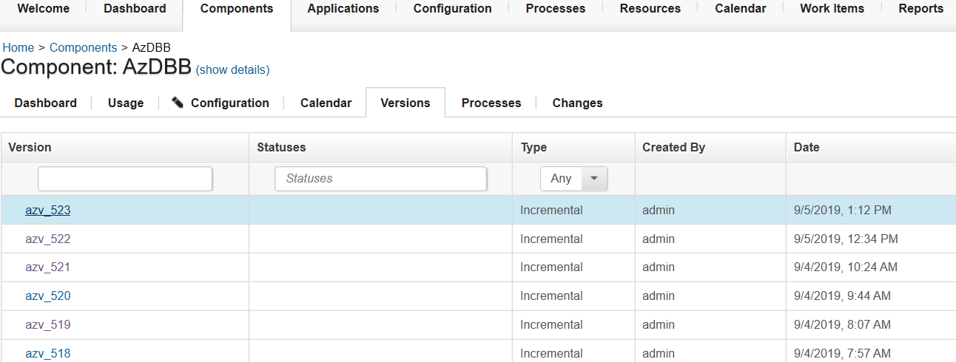
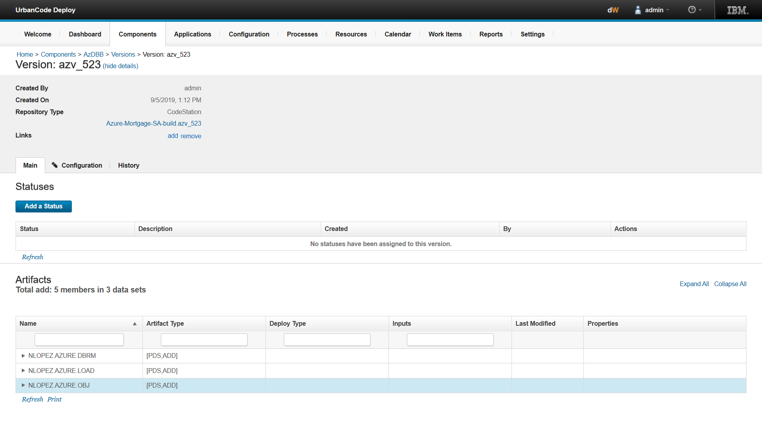
Urban Code Deploy
Artifact Store – Code Station
Link to trace back to DBB Build Report for this release

Slide 17
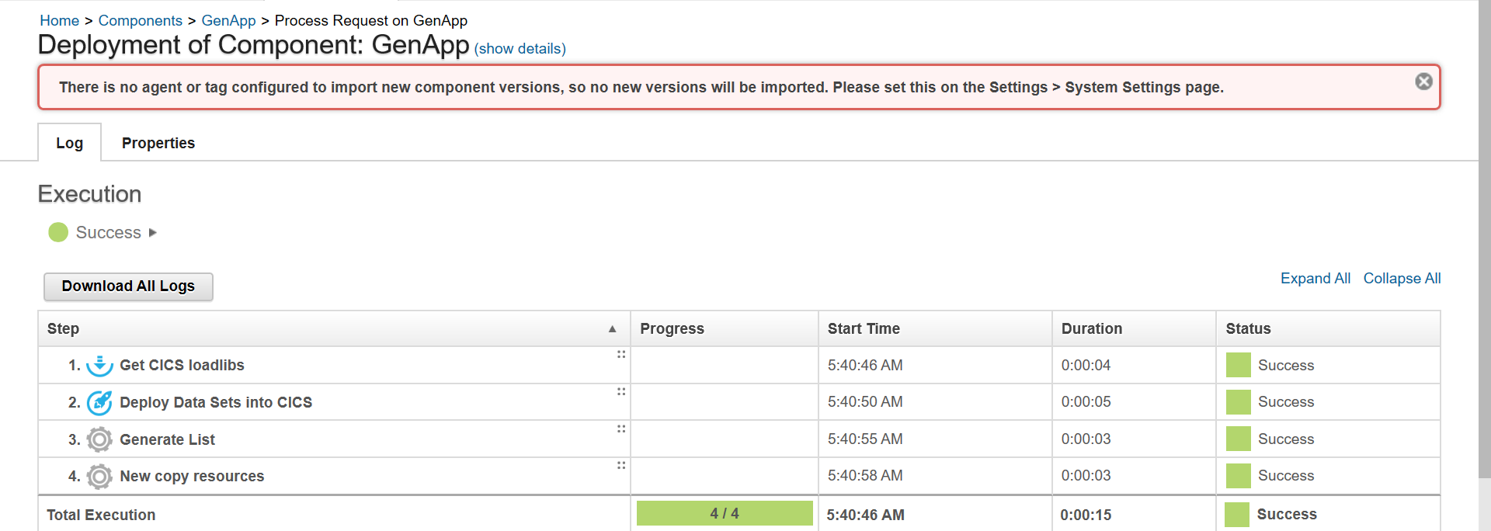
Deployment details

Slide 18






End-to-end Modern z/OS Development with CI/CD
Analysis & Planning
Development Phase
Continuous Deployment
Developer
Sprints
CI - User Builds
Ops
. Automated Impact Analysis
. Code Checkout & packaging
. Automated Test environment buildout
Branch
Code
Commit
IDz
zUnit
Report
Build
QA …
PROD
Master
Git
Clones
Dev Repo
Pull Requests
zD&T
DBB
zUnit
Git Hub
Jenkins
Urban Code
Modern cross platform/distributed SCM, with audit trails and history
Features
CI - Team Build
Team
Repo
Admin
Lead
SIT
Report
Build`
Code Review
Approve
Merge
Modern Impact Discovery & Analysis with IBM “ADDI” & “DBB”. Automated environment buildout with IBM’s zD&T
Agile workflows supporting parallel and isolated developer sprints as well as integrated team builds
Stage
Deploy
Artifacts
Repo
DBB
zD&T
zUnit
Continuous Delivery
CI - Continuously Integrate new features with automated build, test and reporting. Use zD&T to provision an isolated test environment per developer/team.
(CD) Automated Delivery and Deploy, with versioning and fallback features

Slide 19
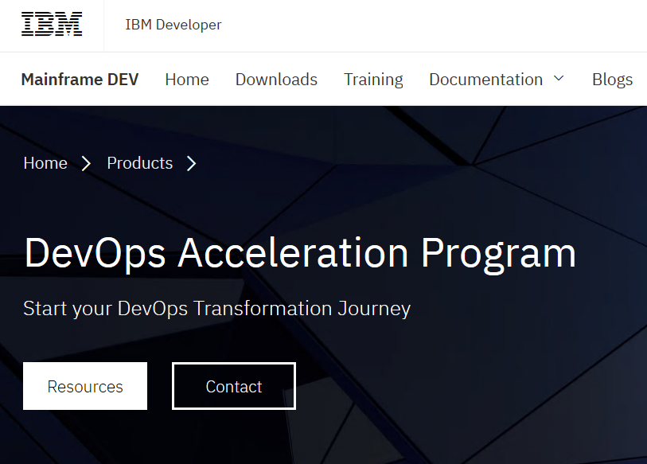
Getting started
IBM’s DevOps Acceleration Program
https://developer.ibm.com/mainframe/products/devops-acceleration-program/

Slide 20
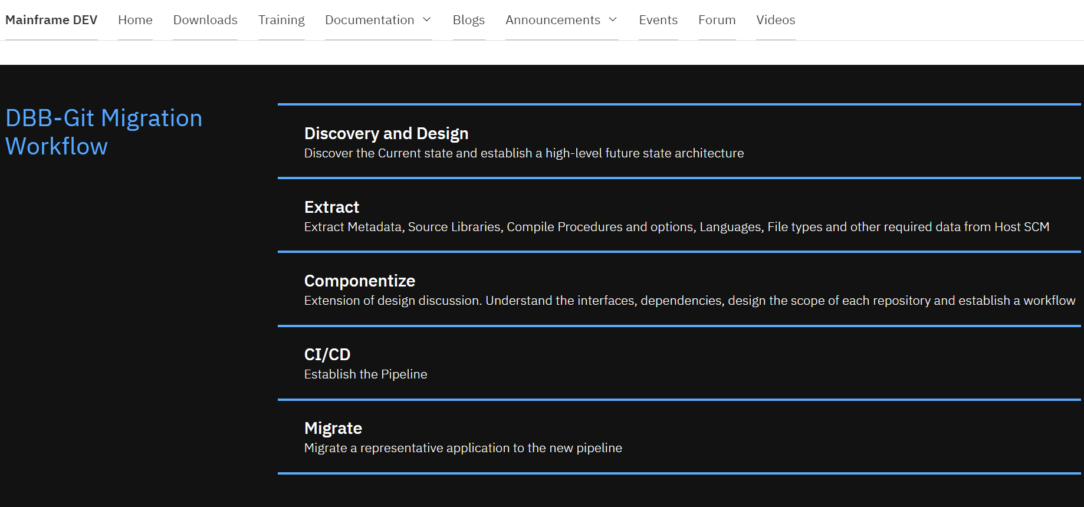
DevOps transformation with IBM’s DevOps Acceleration Program
Notes:
Value Stream Assessment – Executed by SWAT team, offering DevOps VSA Engagement, CI/CD Pipeline Mapping, POV Presentations
Training – Covering Idz, ADDI and CI/CD, it is delivering through Z DevOps Learning team as both instructor led Virtual training and online Self paced training
Deployment – Delivered through Deployment project office , offers upto 52 hours of remote assistance to help deploy IDz and ADDI as per best practices
Adoption – Delivered through DevOps Acceleration Team, the team will start with capturing your current state and based on requirements design your future state. Help with preparing scripts and deploy the future state solution and CI/CD workflow.

Slide 21
Thank You

